Slide 1
The Data Warehouse Toolkit
Second Edition
The Complete Guide To Dimensional Modeling
By Ralgh Kimball-Margy Ross
Chapter 3: Inventory

Slide 2
3.0 Introduction
Chapter 3 discusses the following concepts:
Value chain implications
Inventory periodic snapshot model, as well as transaction and accumulating snapshot models
Semi-additive facts
Enhanced inventory facts
Data warehouse bus architecture and matrix
Conformed dimensions and facts

Slide 3
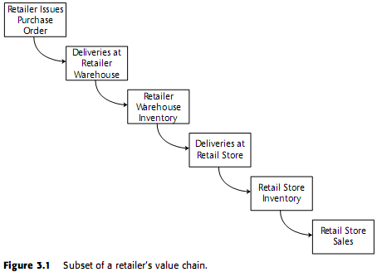
3.1 Introduction to the Value Chain
The value chain identifies the natural, logical flow of an organizationís primary activities.
DSS monitor the performance results of key processes

Slide 4
3.2 Inventory Models
Inventory Periodic Snapshot
Inventory Transactions
Inventory Accumulating Snapshot

Slide 5
3.2.1 Inventory Periodic Snapshot
Optimized inventory levels in the stores.
The retailer needs the ability to analyze daily quantity-on-hand inventory levels by product and store.
In terms of granularity: daily inventory by product at each individual store
Retailer strives to avoid out-of-stock situations

Slide 6
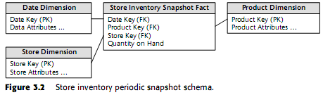
3.2.1 con’t

Slide 7
3.2.1 con’t
Semiadditive Facts
  The quantity on hand are not additive across dates.
  The semiadditive nature of inventory balance facts is even more understandable if we think about our checking account balances.

Slide 8
3.2.1 con’t
All measures that record a static level (inventory levels, financial account balances, and measures of intensity such as room temperatures) are inherently nonadditive across the date dimension and possibly other dimensions. In these cases, the measure may be aggregated usefully across time, for example, by averaging over the number of time periods.

Slide 9
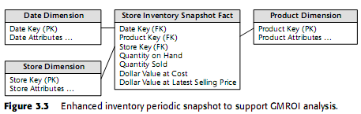
3.2.1 con’t
Enhanced Inventory Facts
The GMROI is a standard metric used by inventory analysts to judge a company’s quality of investment in its inventory.

Slide 10
3.1.2 Inventory Transactions
Inventory transactions at the warehouse might include the following:
Receive product
Place product into inspection hold
Release product from inspection hold
Return product to vendor due to inspection failure
Place product in bin
Authorize product for sale
Pick product from bin
Package product for shipment
Ship product to customer
Receive product from customer
Return product to inventory from customer return
Remove product from inventory

Slide 11
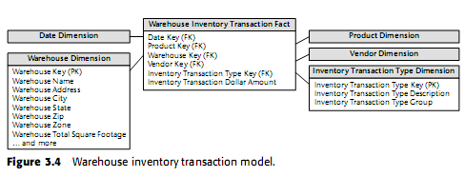
3.1.2 con’t

Slide 12
3.1.2 con’t
How many times have we placed a product into an inventory bin on the same day we picked the product from the same bin at a different time?
How many separate shipments did we receive from a given vendor, and when did we get them?
On which products have we had more than one round of inspection failures that caused return of the product to the vendor?

Slide 13
3.1.2 con’t
Remember that there’s more to life than transactions alone. Some form of snapshot table to give a more cumulative view of a process often accompanies a transaction fact table.

Slide 14
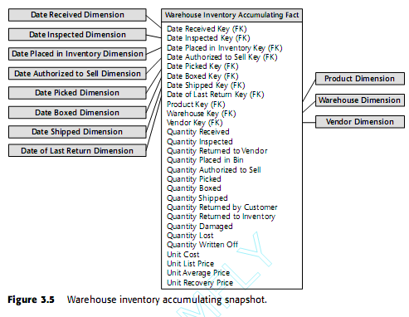
3.1.3 Inventory Accumulating Snapshot

Slide 15
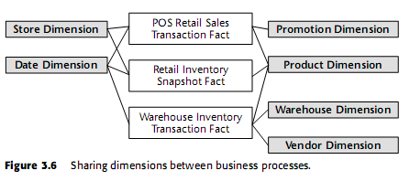
3.2 Value Chain Integration

Slide 16
3.2 con’t
Require the ability to look consistently at customer information across processes.
Allow the organization to better leverage scarce resources and gain efficiencies through the use of reusable components

Slide 17
3.3 Data Warehouse Bus Architecture
We need to use an architected, incremental approach to build the enterprise’s warehouse.
Bus
By defining a standard bus interface for the data warehouse environment, separate data marts can be implemented by different groups at different times. The separate data marts can be plugged together and usefully coexist if they adhere to the standard.

Slide 18
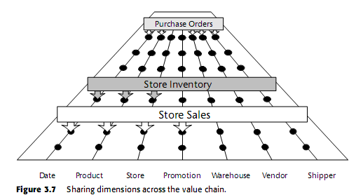
3.3 Con’t

Slide 19
3.3 Con’t
Provide a rational approach to decomposing the enterprise data warehouse planning task.
Allow data warehouse managers to get the best of both worlds
The bus architecture is independent of technology and the database platform

Slide 20
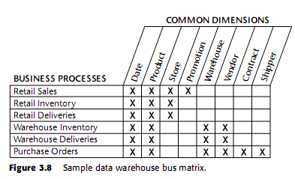
3.3.1 Data Warehouse Bus Matrix

Slide 21
3.3.1 Con’t
Identified with sources of data, not the organization’s business departments
The rows of the bus matrix correspond to data marts. You should create separate matrix rows if the sources are different, the processes are different, or if the matrix row represents more than what can reasonably be tackled in a single implementation iteration.

Slide 22
3.3.1 Con’t
Start the actual implementation with first-level data marts.
Identify more complex multisource marts as a second step
The columns of the matrix represent the common dimensions used across the enterprise
The shaded cells indicate that the dimension column is related to the business process row.
The matrix is a very powerful device for both planning and communication.
The matrix allows us to communicate effectively within and across data mart teams, as well as upward and outward throughout the organization.

Slide 23
3.3.1 Con’t
Creating the data warehouse bus matrix is one of the most important up-front deliverables of a data warehouse implementation. It is a hybrid resource that is part technical design tool, part project management tool, and part communication tool.

Slide 24
3.3.2 Conformed Dimensions
Conformed dimensions are either identical or strict mathematical subsets of the most granular, detailed dimension.
Conformed dimensions have:
  consistent dimension keys
  consistent attribute column names
  consistent attribute definitions
  consistent attribute values

Slide 25
3.3.2 Con’t
Conformed dimensions come in several different flavors
Most conformed dimensions are defined naturally at the most granular level possible
Sometimes dimensions are needed at a rolled-up level of granularity.
Roll-up dimensions conform to the base-level atomic dimension if they are a strict subset of that atomic dimension.

Slide 26
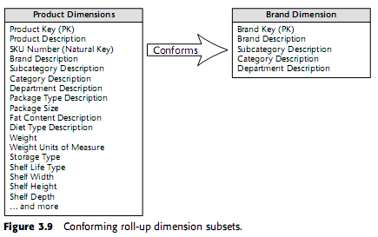
3.3.2 Con’t

Slide 27
3.3.2 Con’t
Another case of conformed dimension subsetting occurs when two dimensions are at the same level of detail but one represents only a subset of rows.

Slide 28
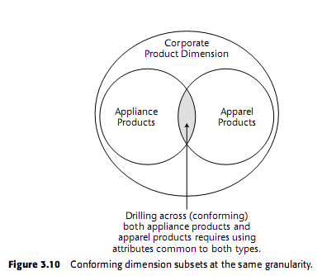
3.3.2 Con’t

Slide 29
3.3.2 Con’t
The major responsibility of the centralized dimension authority is to establish, maintain, and publish the conformed dimensions to all the client data marts.

Slide 30
3.3.3 Conformed Facts
We must be disciplined in our data naming practices. If it is impossible to conform a fact exactly, then you should give different names to the different interpretations. This makes it less likely that incompatible facts will be used in a calculation.

Slide 31
3.3.3 Con’t
Sometimes a fact has a natural unit of measure in one fact table and another natural unit of measure in another fact table

Slide 32
3.4 Summary
Inventory is an important process to measure and monitor in many industries.
Develope dimensional models for the three complementary views of inventory
Introduced key concepts surrounding the data warehouse bus architecture and matrix

